Slide 1

TensorFlow 2.0
PRACTICAL

Slide 2

PROJECT #7 OVERVIEW

Slide 3

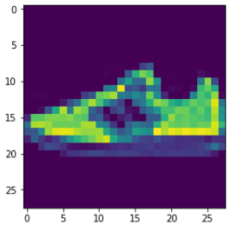
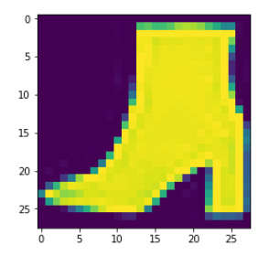
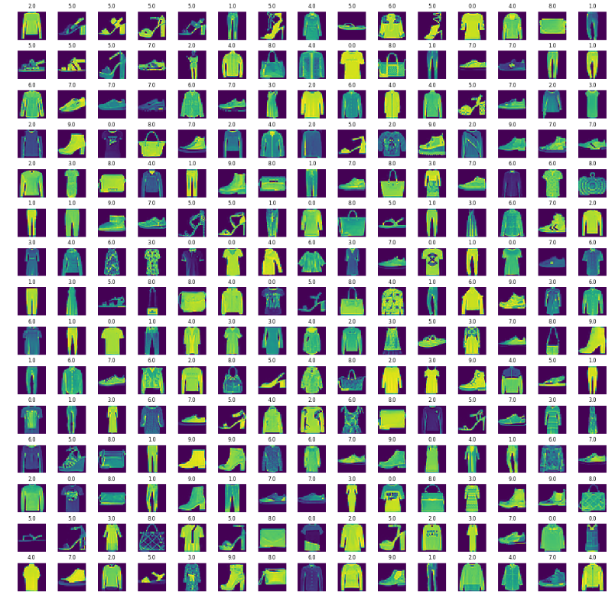
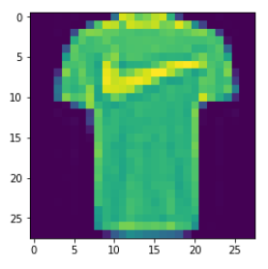
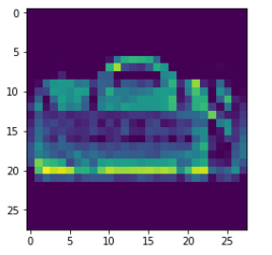
PROJECT #7: PREDICT FASHION CLASSES
TARGET CLASS: 10
INPUT IMAGES
T-SHIRT/TOP
TROUSER
PULLOVER
DRESS
COAT
SANDAL
SHIRT
SNEAKER
BAG
ANKLE BOOT
CLASSIFIER
Fashion consists of 70,000 images
60,000 training
10,000 testing
Images are 28x28 grayscale
TensorFlow 2.0 PRACTICAL

Slide 4
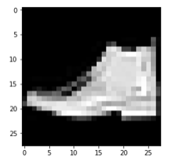
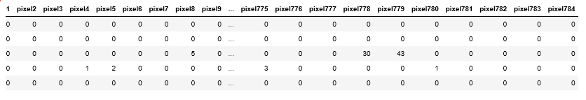
PROJECT #7: PREDICT FASHION CLASSES
Fashion dataset contains 28x28 greyscale image with values ranging from 0-255.
'0' represents black and '255' represents white.
Each image is represented by a row with 784 (i.e.: 28x28) values.
28
28
TensorFlow 2.0 PRACTICAL

Slide 5
WHAT ARE CONVOLUTIONAL NEURAL NETWORKS (CNNS) AND HOW DO THEY LEARN?

Slide 6
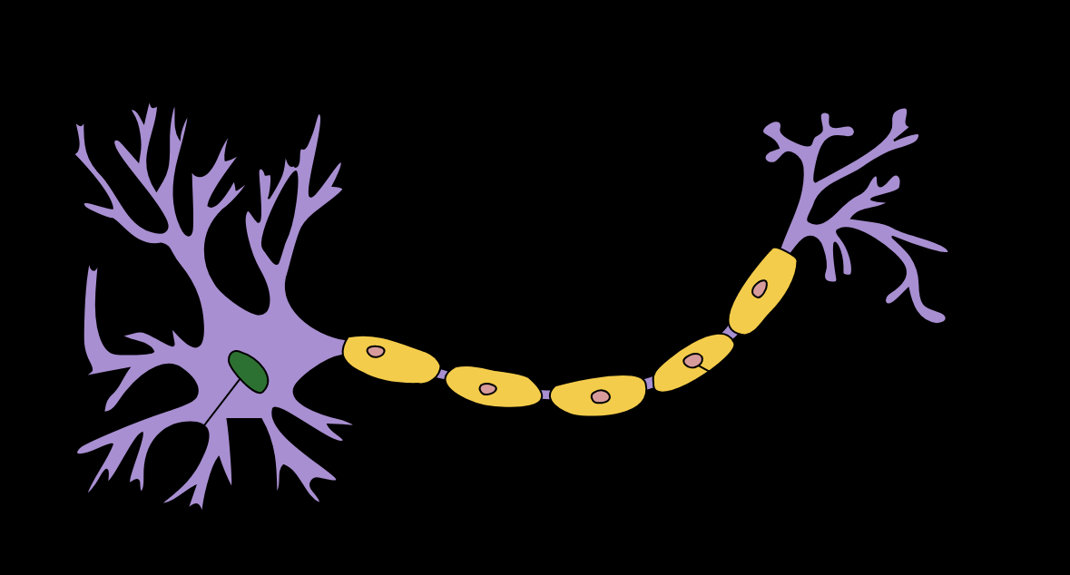
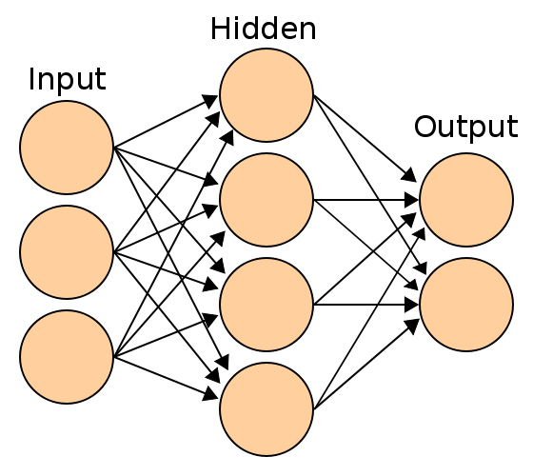
PROJECT #7: CONVOLUTIONAL NEURAL NETWORKS BASICS
The neuron collects signals from input channels named dendrites, processes information in its nucleus, and then generates an output in a long thin branch called the axon.
Human learning occurs adaptively by varying the bond strength between these neurons.
Photo Credit: https://commons.wikimedia.org/wiki/File:Artificial_neural_network.svg
Photo Credit: https://commons.wikimedia.org/wiki/File:Neuron_Hand-tuned.svg

Slide 7
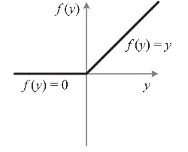
PROJECT #7: CONVOLUTIONAL NEURAL NETWORKS: ENTIRE NETWORK OVERVIEW
T-SHIRT/TOP
TROUSER
PULLOVER
DRESS
COAT
SANDAL
SHIRT
SNEAKER
BAG
ANKLE BOOT
CONVOLUTION
POOLING
FLATTENING
KERNELS/
FEATURE DETECTORS
POOLING FILTERS
CONVOLUTIONAL LAYER
POOLING LAYER (DOWNSAMPLING)
Photo Credit: https://commons.wikimedia.org/wiki/File:Artificial_neural_network.svg

Slide 8
PROJECT #7: FEATURE DETECTORS
Convolutions use a kernel matrix to scan a given image and apply a filter to obtain a certain effect.
An image Kernel is a matrix used to apply effects such as blurring and sharpening.
Kernels are used in machine learning for feature extraction to select most important pixels of an image.
Convolution preserves the spatial relationship between pixels.
FEATURE MAPS
KERNELS/
FEATURE DETECTORS

Slide 9
PROJECT #7: FEATURE DETECTORS
Live Convolution: http://setosa.io/ev/image-kernels/
FEATURE DETECTOR
0 | 1 | 1 | 0 | 1
1 | 0 | 0 | 0 | 1
1 | 1 | 0 | 0 | 0
0 | 1 | 1 | 1 | 0
0 | 0 | 1 | 0 | 1
1 | 0 | 0
0 | 1 | 0
0 | 1 | 0
1
1
1
3
1
1
2
3
1
FEATURE MAP
IMAGE

Slide 10

PROJECT #7: RELU (RECTIFIED LINEAR UNITS)
RELU Layers are used to add non-linearity in the feature map.
It also enhances the sparsity or how scattered the feature map is.
T-SHIRT/TOP
TROUSER
PULLOVER
DRESS
COAT
SANDAL
SHIRT
SNEAKER
BAG
ANKLE BOOT
CONVOLUTION
POOLING
FLATTENING
KERNELS/
FEATURE DETECTORS
POOLING FILTERS
CONVOLUTIONAL LAYER
POOLING LAYER (DOWNSAMPLING)
Photo Credit: https://commons.wikimedia.org/wiki/File:Artificial_neural_network.svg

Slide 11
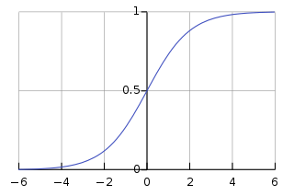

PROJECT #7: RELU (RECTIFIED LINEAR UNITS)
RELU Layers are used to add non-linearity in the feature map.
It also enhances the sparsity or how scattered the feature map is.
The gradient of the RELU does not vanish as we increase x compared to the sigmoid function
7 | 10 | -5 | 2 | 1
1 | 0 | 2 | 3 | -6
1 | 17 | -5 | 0 | 0
0 | 1 | 1 | 1 | 0
0 | 0 | -8 | 12 | 1
7 | 10 | 0 | 2 | 1
1 | 0 | 2 | 3 | 0
1 | 17 | 0 | 0 | 0
0 | 1 | 1 | 1 | 0
0 | 0 | 0 | 12 | 1
Photo Credit: https://commons.wikimedia.org/wiki/File:Artificial_neural_network.svg

Slide 12
PROJECT #7: POOLING (DOWNSAMPLING)
Pooling or down sampling layers are placed after convolutional layers to reduce feature map dimensionality.
This improves the computational efficiency while preserving the features.
Pooling helps the model to generalize by avoiding overfitting.
If one of the pixel is shifted, the pooled feature map will still be the same.
Max pooling works by retaining the maximum feature response within a given sample size in a feature map.
Live illustration : http://scs.ryerson.ca/~aharley/vis/conv/flat.html
1 | 1 | 3 | 4
3 | 6 | 2 | 8
3 | 9 | 1 | 0
1 | 3 | 3 | 4
6
MAX POOLING
6
8
FLATTENING
8
9
4
9
2x2
STRIDE = 2
4
Photo Credit: https://commons.wikimedia.org/wiki/File:Artificial_neural_network.svg

Slide 13
HOW TO IMPROVE NETWORK PERFORMANCE?

Slide 14
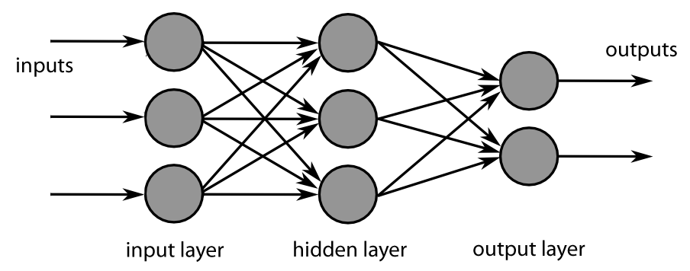
PROJECT #7: INCREASE FILTERS/DROPOUT
Improve accuracy by adding more feature detectors/filters or adding a dropout.
Dropout refers to dropping out units in a neural network.
Neurons develop co-dependency amongst each other during training
Dropout is a regularization technique for reducing overfitting in neural networks.
It enables training to occur on several architectures of the neural network
KERNELS/
FEATURE DETECTORS
64 INSTEAD OF 32
Photo Credit: https://fr.m.wikipedia.org/wiki/Fichier:MultiLayerNeuralNetworkBigger_english.png

Slide 15
CONFUSION MATRIX

Slide 16
PROJECT #7: CONFUSION MATRIX
TRUE CLASS
+
-
TYPE I ERROR
+
TRUE +
FALSE +
PREDICTIONS
FALSE -
TRUE -
-
TYPE II ERROR

Slide 17
PROJECT #7: CONFUSION MATRIX
A confusion matrix is used to describe the performance of a classiﬁcation model:
True positives (TP): cases when classiﬁer predicted TRUE (they have the disease), and correct class was TRUE (patient has disease).
True negatives (TN): cases when model predicted FALSE (no disease), and correct class was FALSE (patient do not have disease).
False positives (FP) (Type I error): classiﬁer predicted TRUE, but correct class was FALSE (patient did not have disease).
False negatives (FN) (Type II error): classiﬁer predicted FALSE (patient do not have disease), but they actually do have the disease

Slide 18
PROJECT #7: KEY PERFORMANCE INDICATORS (KPI)
Classiﬁcation Accuracy = (TP+TN) / (TP + TN + FP + FN)
Misclassiﬁcation rate (Error Rate) = (FP + FN) / (TP + TN + FP + FN)
Precision = TP/Total TRUE Predictions = TP/ (TP+FP) (When model predicted TRUE class, how often was it right?)
Recall = TP/ Actual TRUE = TP/ (TP+FN) (when the class was actually TRUE, how often did the classiﬁer get it right?)

Slide 19
PROJECT #7: PRECISION Vs. RECALL EXAMPLE
TRUE CLASS
+
-
TP = 1
FP = 1
+
PREDICTIONS
-
FN = 8
TN = 90
Classiﬁcation Accuracy = (TP+TN) / (TP + TN + FP + FN) = 91%
Precision = TP/Total TRUE Predictions = TP/ (TP+FP) = ½=50%
Recall = TP/ Actual TRUE = TP/ (TP+FN) = 1/9 = 11%

